Slide 1

Boston Airbnb
This Photo by Unknown Author is licensed under CC BY-NC-ND

Slide 2





Meet The Team Brynna Bridges De-Anna Clarke Chantay Drake Jewell Foster Alexis Palmer
This Photo by Unknown Author is licensed under CC BY
This Photo by Unknown Author is licensed under CC BY

Slide 3

Motivation & Summary We are a data analytics team that works for small business consulting firm. One of our clients would like to purchase 3 properties in a prominent Boston area for rental through Airbnb. They tasked us to provide them a profile of the most profitable investments to make base on Neighborhood, Property type and bedrooms.
This Photo by Unknown Author is licensed under CC BY

Slide 4

Hypothesis & Null Hypothesis
Research Question: Is there a significant difference between neighborhoods to purchase property in Boston.
Hypothesis: Buying an Airbnb two-bedroom apartment located in Jamaica Plain is significantly better than other neighborhoods based on price and ratings.
Null Hypothesis: There is no significant difference in neighborhoods in relevance to purchasing property.
This Photo by Unknown Author is licensed under CC BY

Slide 5
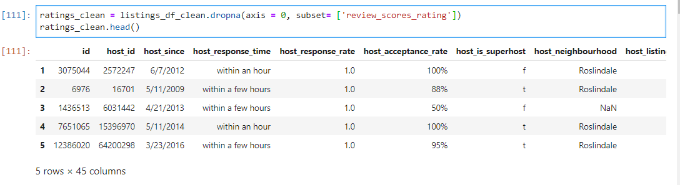
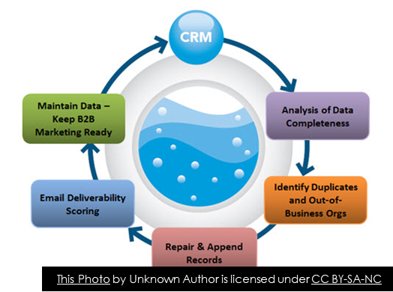
Data Used, Cleanup & Exploration

Slide 6
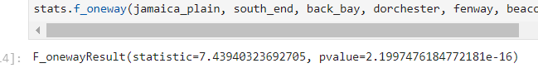
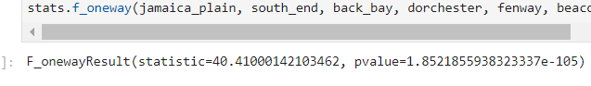
P- Values
RATINGS
PRICE

Slide 7
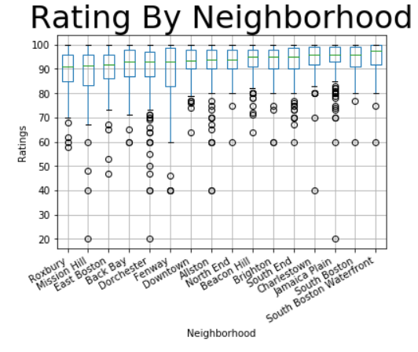
Ratings By Neighborhood

Slide 8
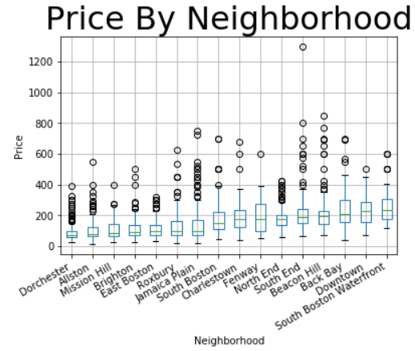
Price By Neighborhood

Slide 9
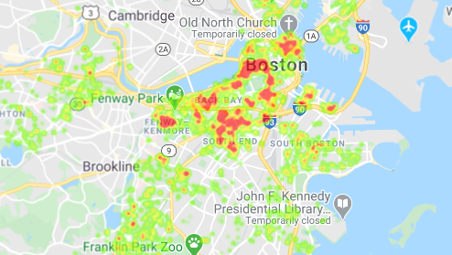
Pricing Heat Map

Slide 10
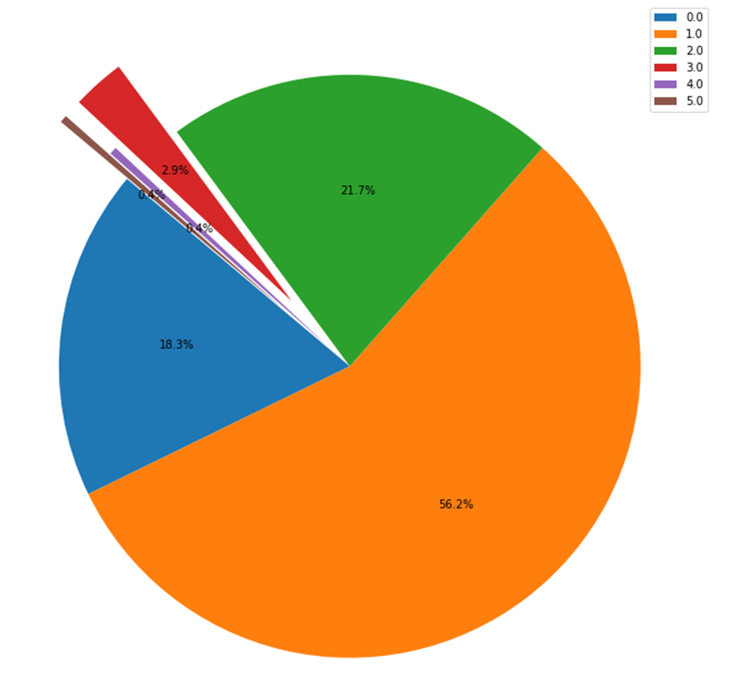
Number of Bedrooms in South End
Number of Bedrooms in
South End

Slide 11
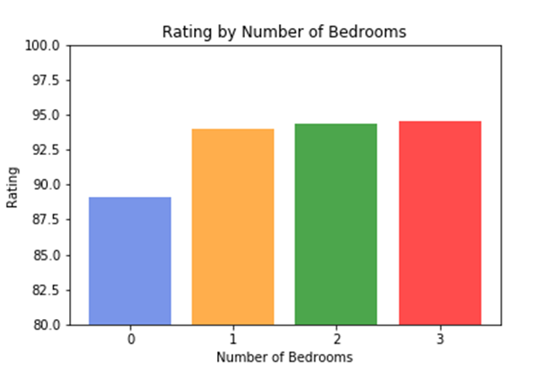
Rating By Bedrooms

Slide 12
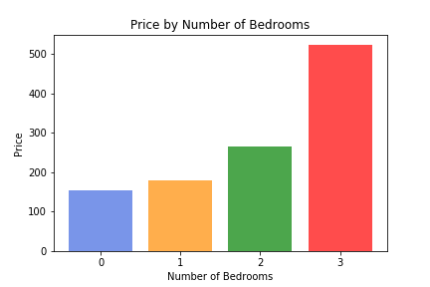
Price By Available Bedrooms

Slide 13
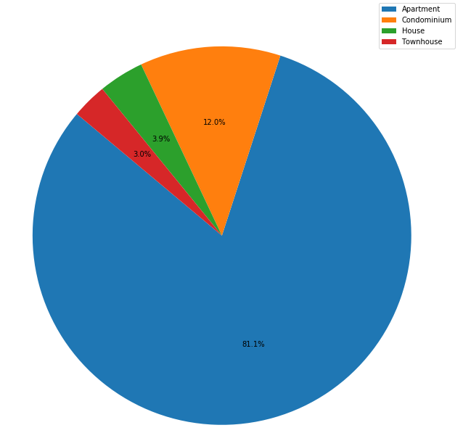
South End Property Type
South End Property Type

Slide 14
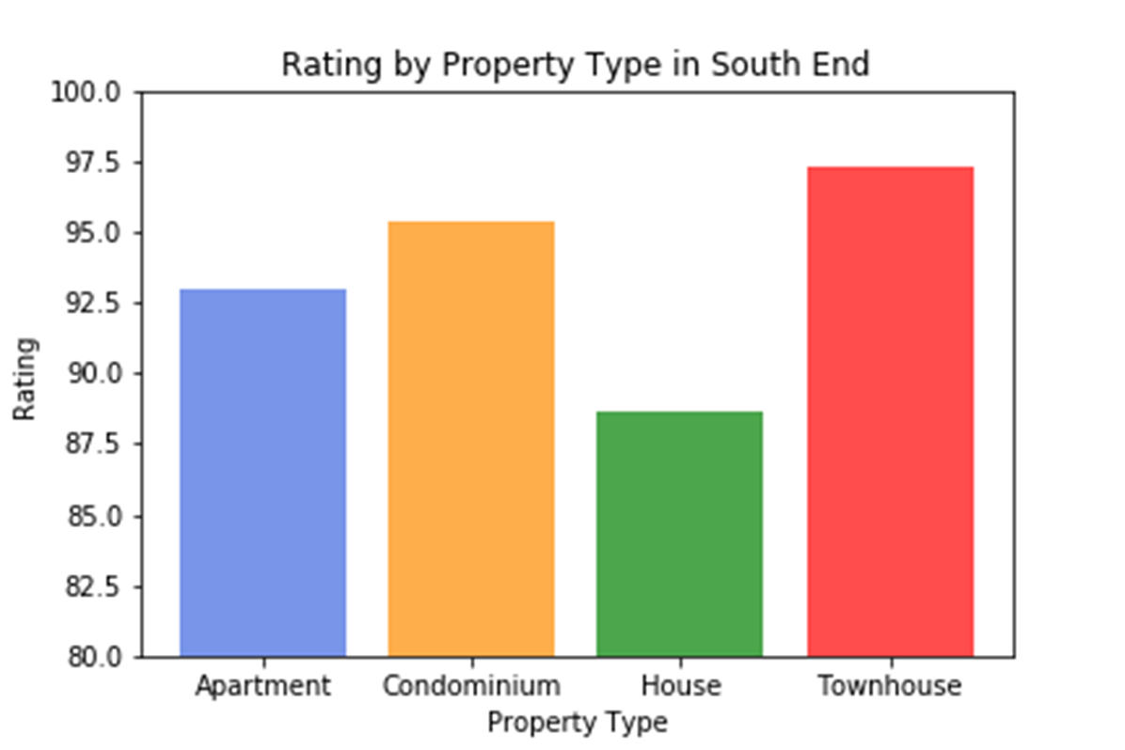
South End’s Rating By Property Type

Slide 15
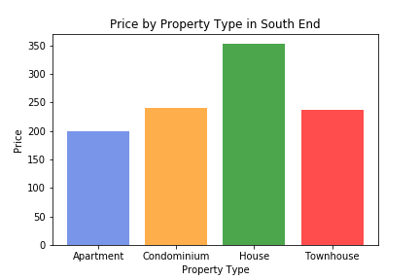
Price By Property Type In South End

Slide 16

Conclusion
This Photo by Unknown Author is licensed under CC BY-SA-NC

Slide 17
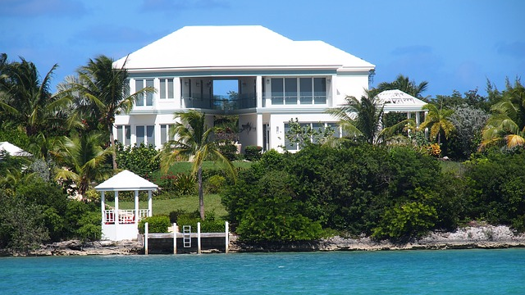
Postmortem

